Slide 1
Command and Control Data Link Subsystem(UL.32, STANAG-4703)(1/2)
-Minimum flight and navigation information
: indicated airspeed - Applied
: ground speed - Applied
: pressure altitude and related altimeter setting -Not applied
: heading - Applied
: track - Applied
: UA position on a map at a scale selectable by the operator
;A flight path deviation warning must be displayed and the appropriate procedure
must be established -Not applied
: deviation between the planned ground track & the actual UA flight path -Not applied
: UA position relative to the LOS data link transmitter/receiver displayed in terms of range,
bearing and altitude -Applied
: Where semi-automatic flight control modes are activated, the commanded flight/navigation
parameters sent to the UAV must be displayed -Applied
: Airspeed minimum and maximum limitations and corresponding speed warnings -Not applied
: UA altitude -Applied
: Vertical speed -Applied
: navigation system status -Applied
: g-meter -Not applied
-The minimum propulsion system data
: for electric engines
; remaining level of battery charge -Applied
: a means to indicate engine health status
; engine RPM -Not applied
; case temperature -Not applied
; corresponding caution and warning alerts when specified minimum/maximum
limitations are being approached, reached, and/or exceeded -Not applied
REF : NSA, “STANAG 4703 Edition 1: Light Unmanned Aircraft Systems Airworthiness Requirements (USAR-LIGHT), Final Draft“, NATO Standardization Agency, 2011

Slide 2
Command and Control Data Link Subsystem(UL.26, STANAG-4703) (2/2)
-Uplink, Downlink
-Downlink must include
: Navigational information -Applied
: Response to UA crew commands -Applied
: Equipment operating parameters(UL.32) -Applied
-Warning cues should be provided to alert the operator of detrimental degradation in data link
capabilities such as
: approaching antenna masking attitudes -Not applied
: approaching external interfering antennas -Not applied
: approaching maximum data link range -Not applied
-In case of data link loss, an automatic reacquisition process must try to re-establish the command
and control data link in a time period
: a warning must alert the operator, and the applicant must specify whether the alert
will be audible, visual, or both
: the alert should sound/be displayed continoususly until acknowledged and extinguished
: loss strategy must be established
REF : NSA, “STANAG 4703 Edition 1: Light Unmanned Aircraft Systems Airworthiness Requirements (USAR-LIGHT), Final Draft“, NATO Standardization Agency, 2011

Slide 3
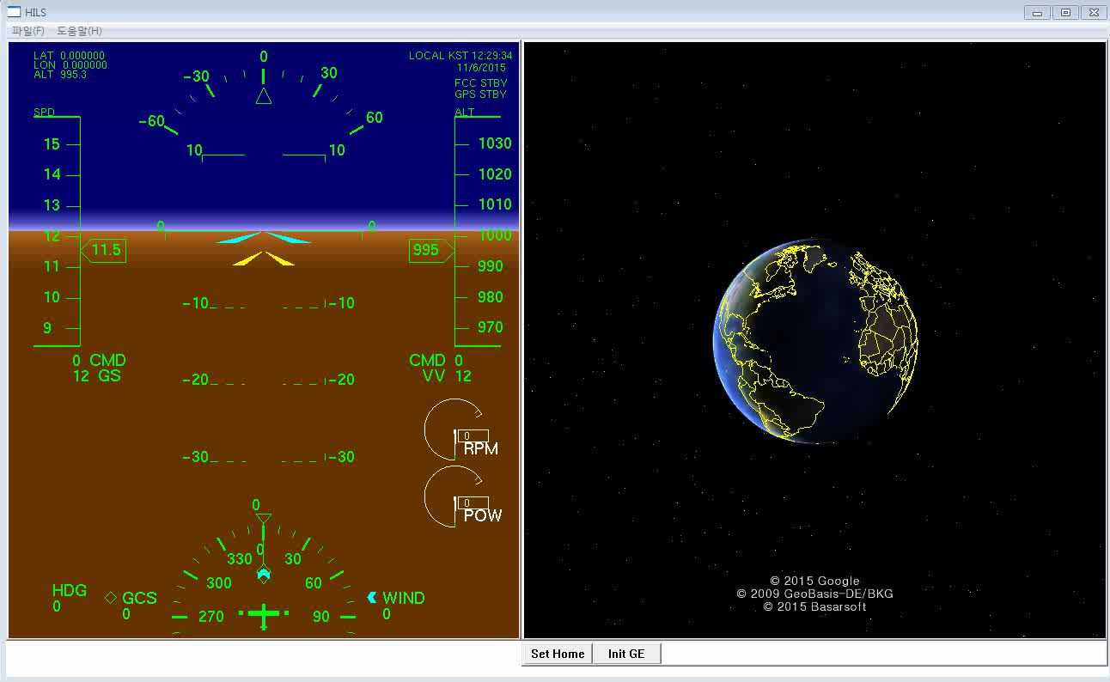
HILS combined with Man-Machine Interface
-Man-Machine Interface has been combined with aircraft nonlinear simulation system
: Functionalities for operating HILS will be updated until next week
; GUI interface for serial communication
; MAVLink system
; Network link with Google Earth for indicating UAV track
; Interfaces for initializing Google Earth and setting LLA parameters from Google Earth

Slide 4
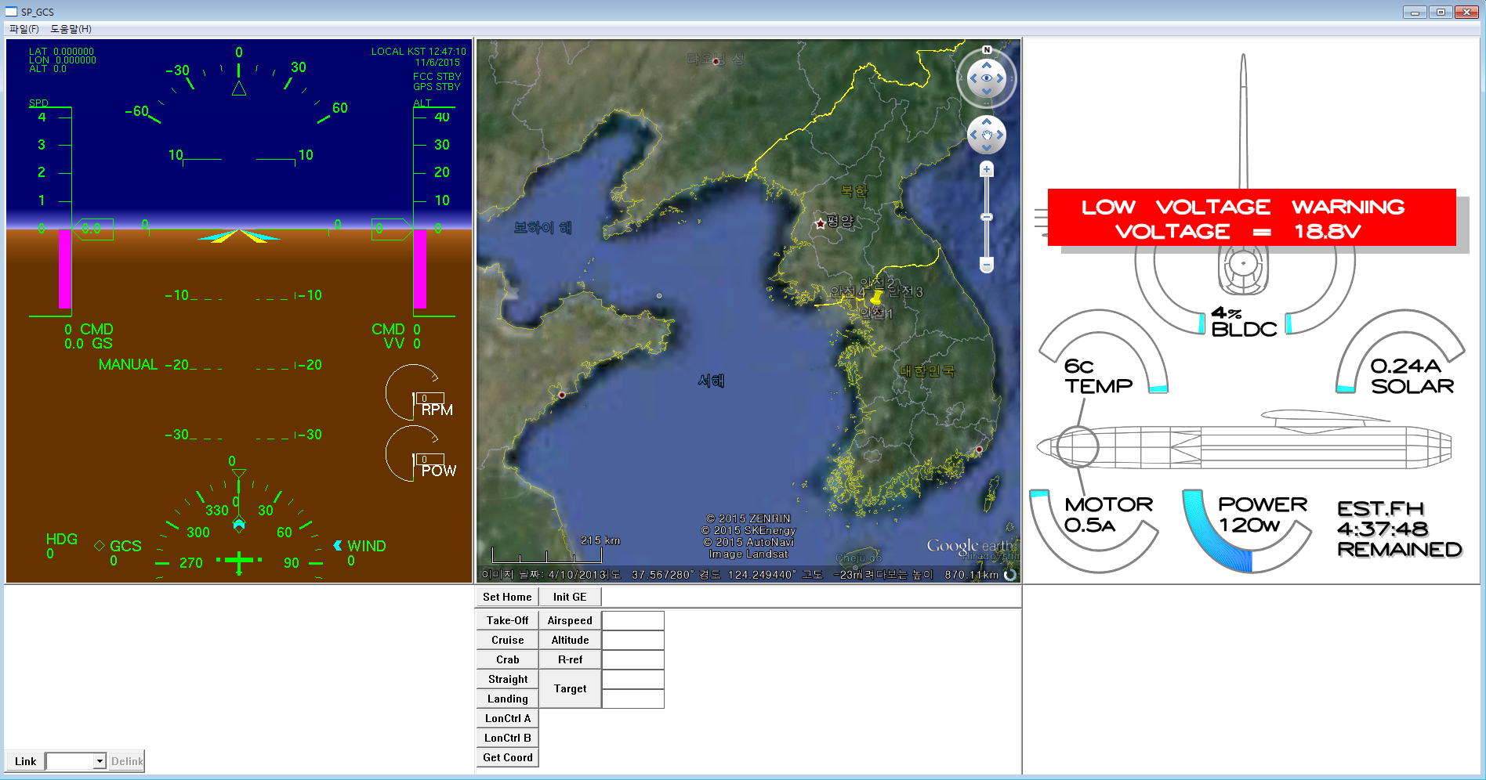
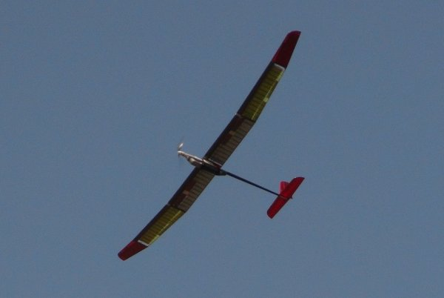
Appendix : Application using Developed MMI-Interface
-Ground Control System for Solar Powered UAV is in developing
: MMI Interface developed in this class is now applied to Ground Control Station for
operating and monitoring Solar Powered UAV
: Some regulations that are not applied to HILS system refered in page 1~2 are
applied in this project such as
: Navigational Information
: Response to UA crew commands
: Warning cues

